Slide 1
Chem-Art
Kensington Woods Schools Integration
Rbrown.kwoods.org

Slide 2
Science-Arts Integration at KWoods
Begin to bridge the gap between theory and practice.
GOAL: Practice integration of “mutual respect.”
Science informs art in a variety of ways.
What is possible?
Art informs science in a variety of ways.
What can be explored?
Without the other, the project is not possible.
Eventually: PBL in sciences.
Makerspace.
Design, building, architecture, fine arts….the lot.

Slide 3
What makes this possible (for us)…
Time dedicated to collaboration.
Curriculum director = art teacher.
Culture of PBL.
Small school.
Open to trying out new things…

Slide 4
Date with Density

Slide 5
The Science Lead-In: Scientific Thinking
While studying the Nature of Science…
How might we gather and organize inquiry-based exploration?
What makes a “testable hypothesis?”
Is the scientific method flexible?

Slide 6
The Transition: BLV Challenge
Can we use scientific inquiry to crack a secret art recipe?
What other amazing things will we discover along the way?
Scientific ideas we use in the pursuit of artistic technique…
Density
Solubility
Visual organization of information (cross-curricular)

Slide 7
Setting Up
Students brainstorm and bring in a variety of materials in two categories:
The color
The base
They will try to choose from a range of densities and solubility/insolubility.

Slide 8
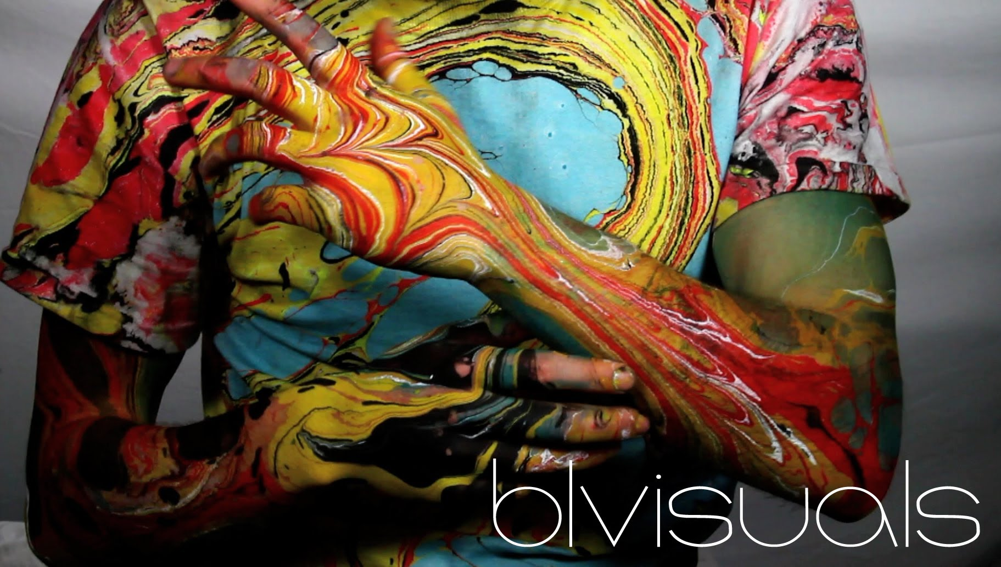
Density Lab
Enduring Understandings:
Inquiry-based exploration can be supported and improved through collaboration.
Topical Ideas:
Artists can use scientific understanding to expand their creative toolbox.
Vocab:
Density
Solubility
Texture

Slide 9
The Open Challenge: Further Exploration
Refine your process with narrowing hypothesis and testing.
Using visual comparisons to pinpoint other density-driven phenomenon.
Track this technique through other cultures’ art.
Turkish cloud painting
Italian endpaper marbling
http://www.pxleyes.com/blog/2012/03/cloud-formations-photography/

Slide 10
TENSEGRITY

Slide 11
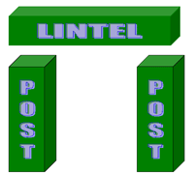
The Pre-Activity:
Students have 15 min. to build as tall a tower as possible. Many materials available.
Time’s up. Look at the structures. What patterns do we see? How many types of structures could we group?
http://architectureppf.com/ppf/chapter_1/1b.aspx

Slide 12
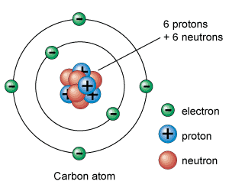
The Science Lead-In: Imperfect Models
http://www.universetoday.com/56637/atom-model/

Slide 13
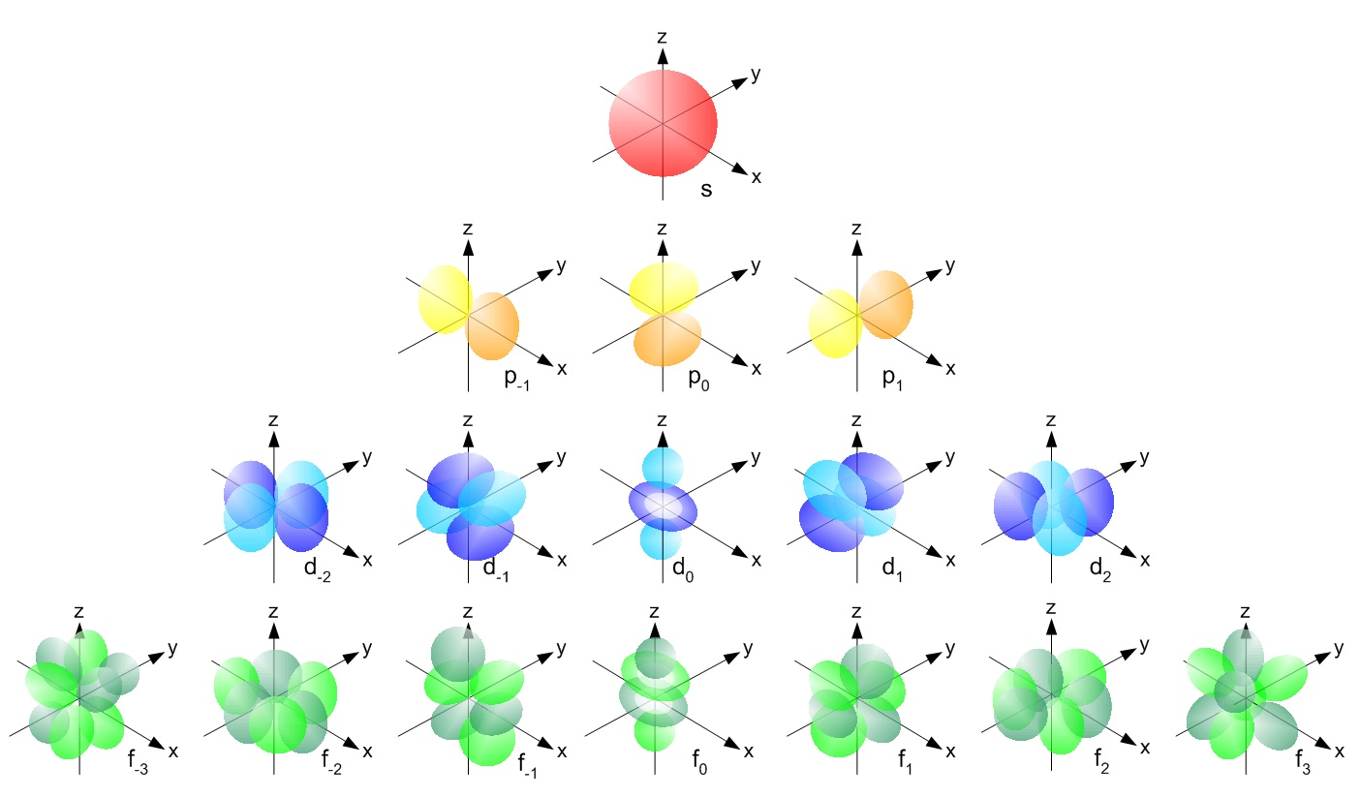
Imperfect Models (each can only tell a piece of the story).

Slide 14
Complex Forms
Built from a set of basic rules…

Slide 15
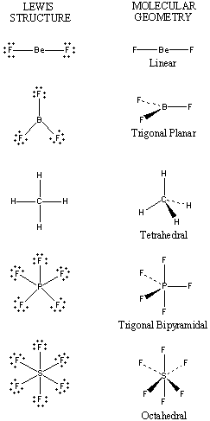
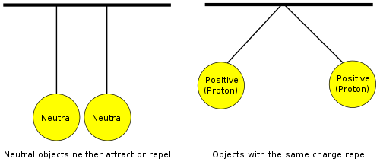
Atomic Structure and Tensegrity
https://en.wikibooks.org/wiki/High_School_Chemistry/Atomic_Terminology
http://chemed.chem.purdue.edu/genchem/topicreview/bp/ch8/vsepr.html

Slide 16
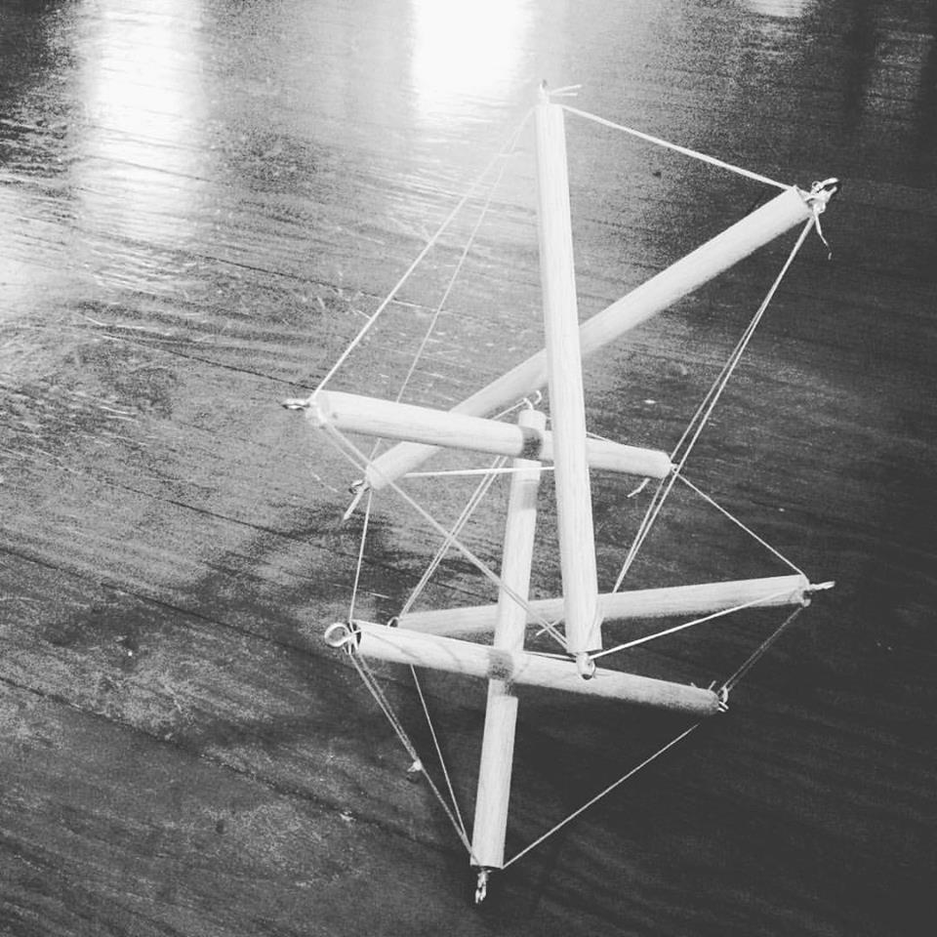
The Transition: Tensegrity Tower Instructions
Enduring Understandings:
Switching up basic assumptions of “how things work” can yield interesting and unexpected results.
Topical Ideas:
Studying nature can expand our understanding of design possibility.
Vocab:
Biomimicry
Tensegrity
http://www.instructables.com/id/Desktop-Tensegrity-Tower/

Slide 17
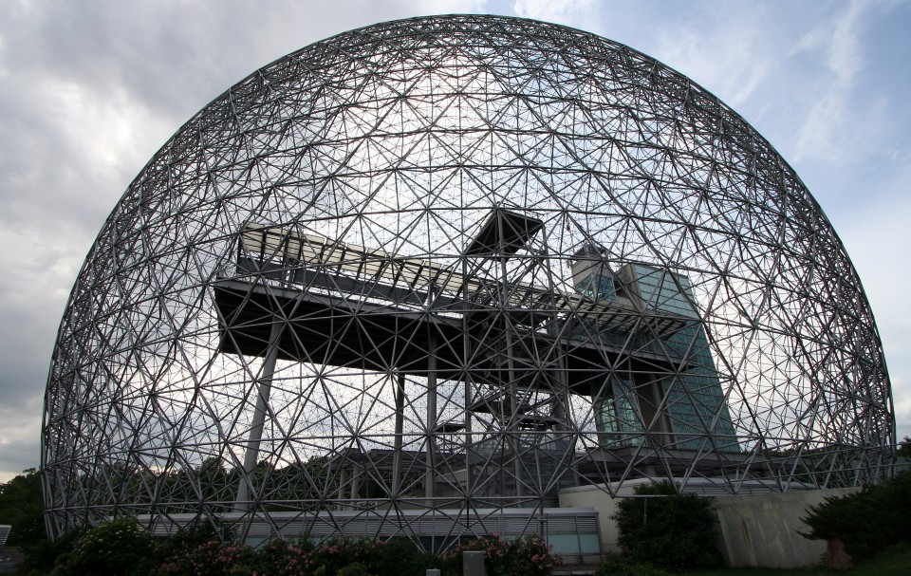
The Open Challenge: Biomimicry
Who else works with these concepts?
What can be done?
http://www.spatialagency.net/database/why/political/buckminster.fuller

